Slide 1
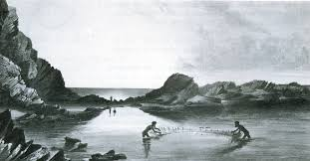
Traditional Aboriginal use of the sea

Slide 2
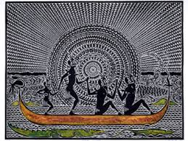
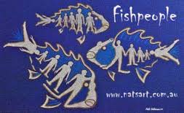
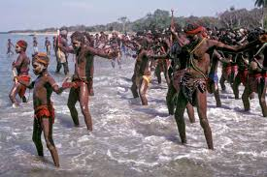
Australia is an island continent
Brainstorm what you think the traditional Aboriginal people used the sea for.

Slide 3
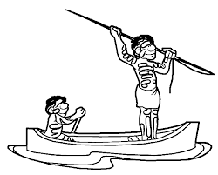
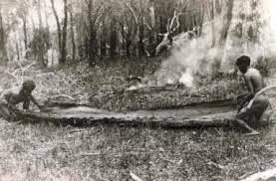
Due to the fact that Aboriginal people were isolated from the rest of the world by oceans.
They had some watercraft such as bark and dug out canoes and rafts.
But none of these watercraft were able to handle rough seas or make long journeys.

Slide 4
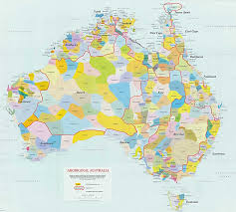
Lots of Aboriginal groups occupied lots of the vast coastal areas of Australia.
Also many of the inland groups travelled to the coast when they did their seasonal migration.

Slide 5
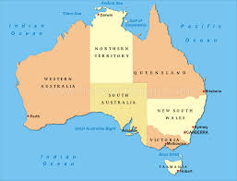
The lifestyle and food available at the coast varied.
Write down in your files why you think it was different.

Slide 6
Of course it was because Australia is so large.
There are different climates in Australia
And
Different geographical regions

Slide 7
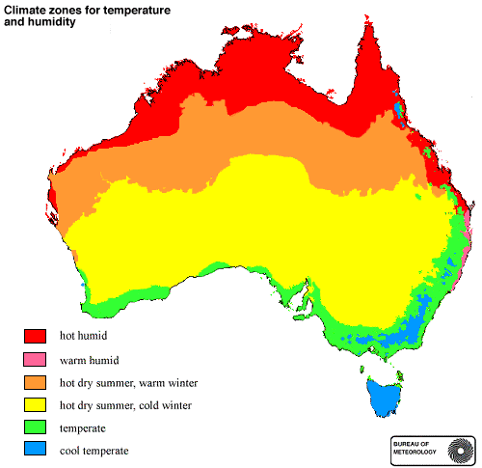
Climate Zones in Australia

Slide 8
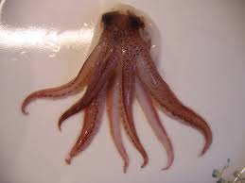
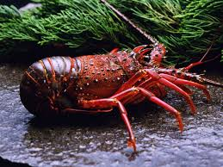
What kinds of food do you think the Aboriginals found at the sea?
Do a brainstorm in your file about all the different food you think they ate at the sea.

Slide 9
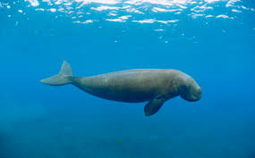
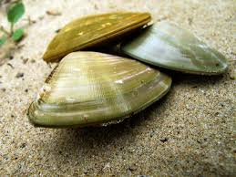
All traditional men and women were expert at fishing they caught and ate things like;
Fish, dugongs, seal, turtles, pipis, shellfish, oysters and crabs.

Slide 10
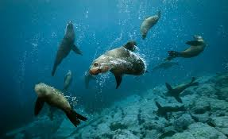
Ways they fished.
From their bark or dugout canoes
By diving deep to spear
Also using camouflage and tricks – the women would mime the actions and make seal sounds to trick the seals so the men could catch them.

Slide 11
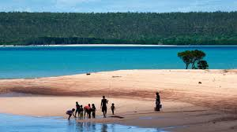
Traditional Aboriginals also used the sea to clean themselves.

Slide 12
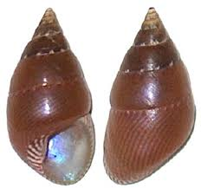
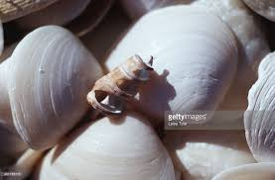
They also collected shells.
Do a brainstorm to show what you think they used shells for.

Slide 13
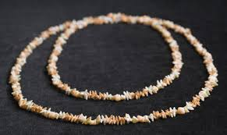
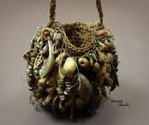
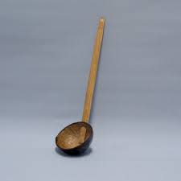
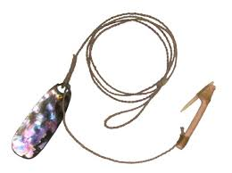
Shells were used for;
Utensils
Spear points
Blades
Playthings ornaments
Musical instruments

Slide 14
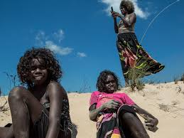
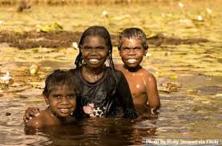
Traditional aboriginals also used the sea for fun just as we do.

Slide 15
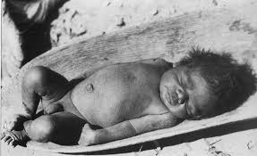
They used the sand to put into their babies cradles.
It was soft
And it could be changed easily.

Slide 16
They also used the sand for art.
How do you think they used the sand for art?

Slide 17
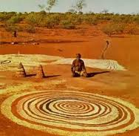
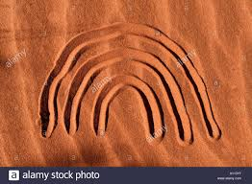
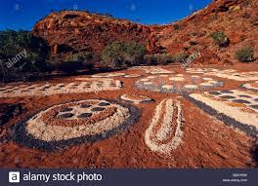
They made non permanent sand pictures and patterns
They also used the sand and mixed it with gum to create rock art.

Slide 18
Traditional Aboriginals used things they found at the coast for medicine.
What do you think they found and used?

Slide 19
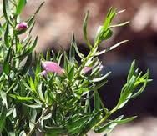
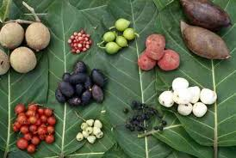
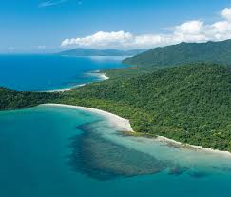
Some things were
Seaweed
Leaves
Bark
Blossoms from coastal plants ( particularly in tropical rainforest areas)

